Slide 1

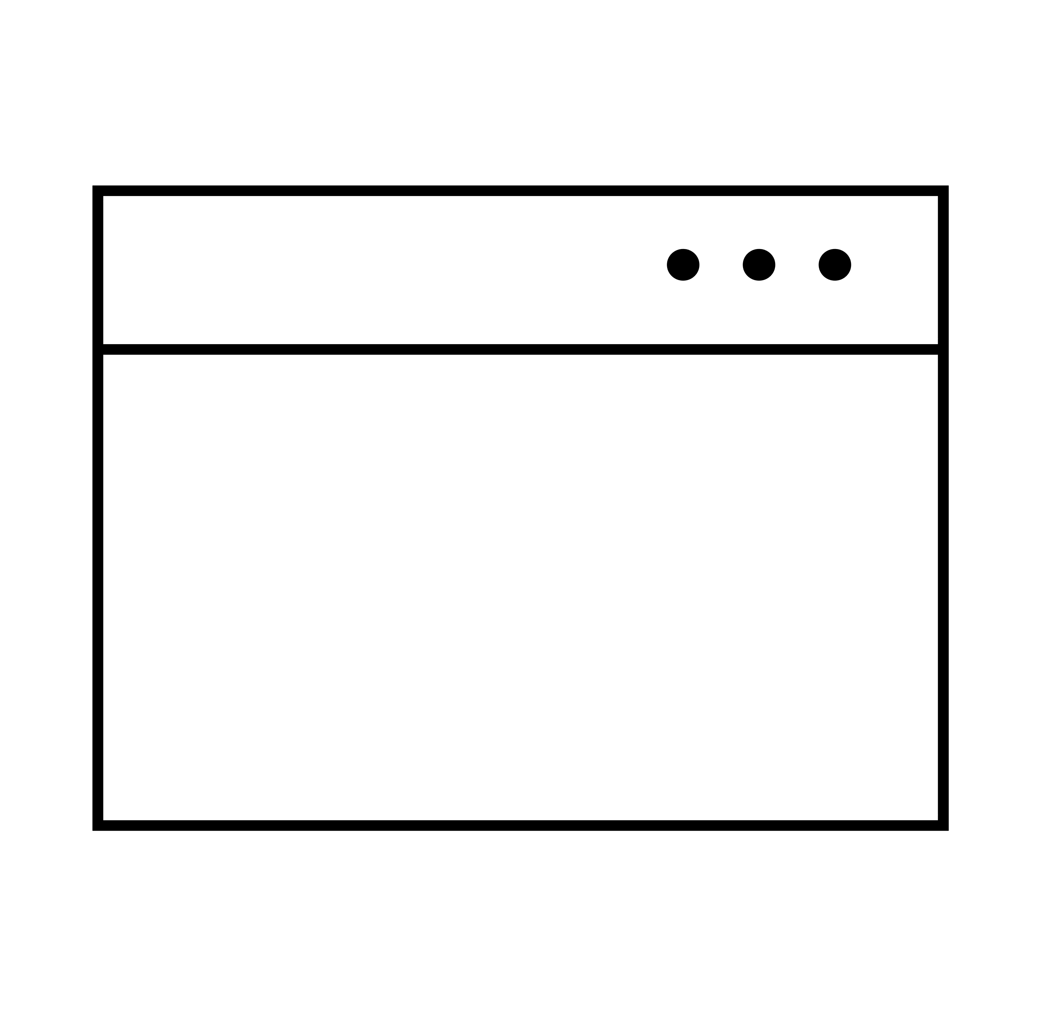




Username
Password
Login
Authentication and its Vulnerabilities

Slide 2
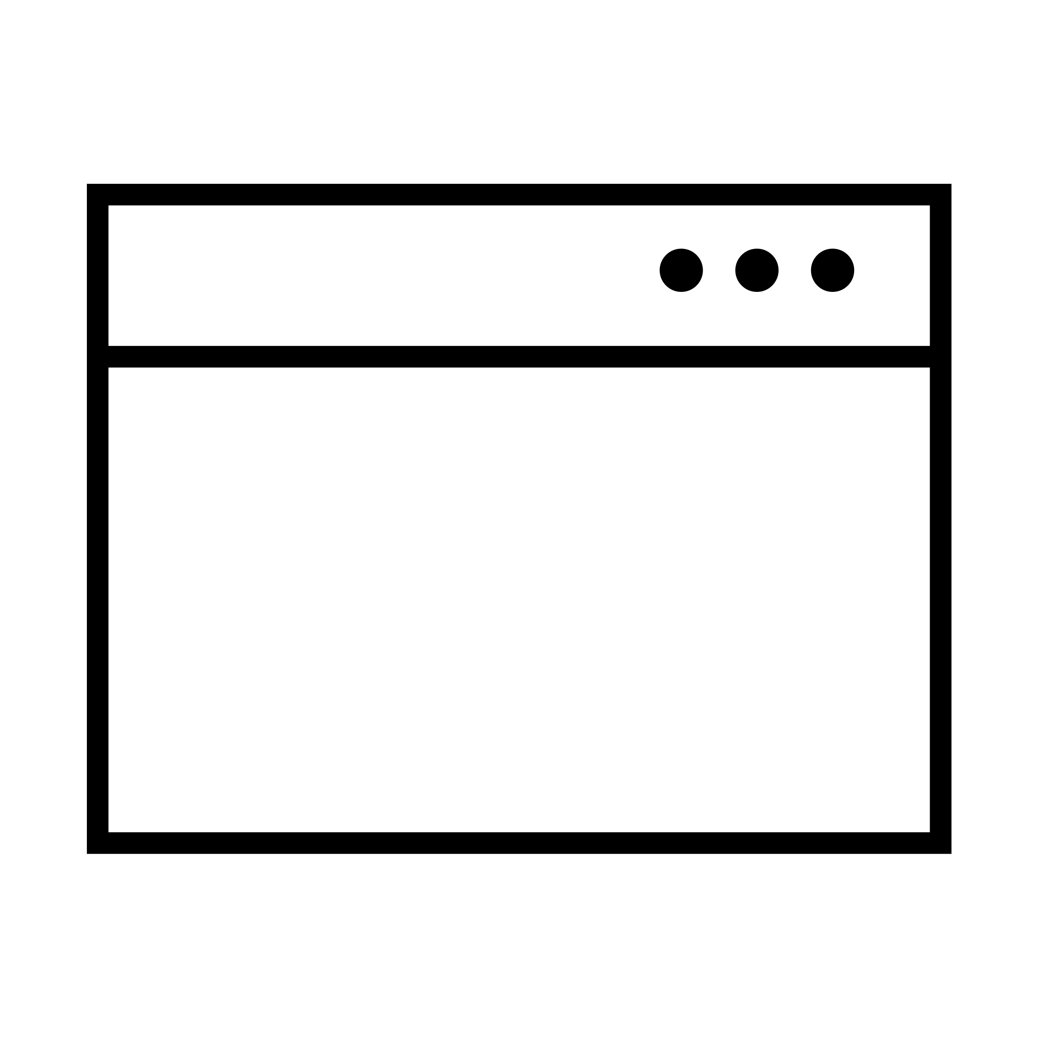
Some Terminology...
Authentication identifies the user and confirms that they say who they say they are.
HTML form-based authentication
Multi-factor mechanisms
Windows-integrated authentication using NTLM or Kerberos
...
Username
Password
Log In
Notes:
NTLM (New Technology LAN Manager) is an authentication protocol that was introduced in Windows NT 4.0 and has been supported in all subsequent versions of Windows¹. It is based on symmetric key cryptography and uses a challenge/response mechanism to authenticate users
Kerberos is an authentication protocol that is based on symmetric key cryptography and relies on a trusted third party, called the Key Distribution Center (KDC)². It is the default authentication protocol on Windows versions above W2k, replacing the NTLM authentication protocol

Slide 3
Authentication Vulnerabilities arise from insecure implementation of the authentication mechanisms in
an application.

Slide 4
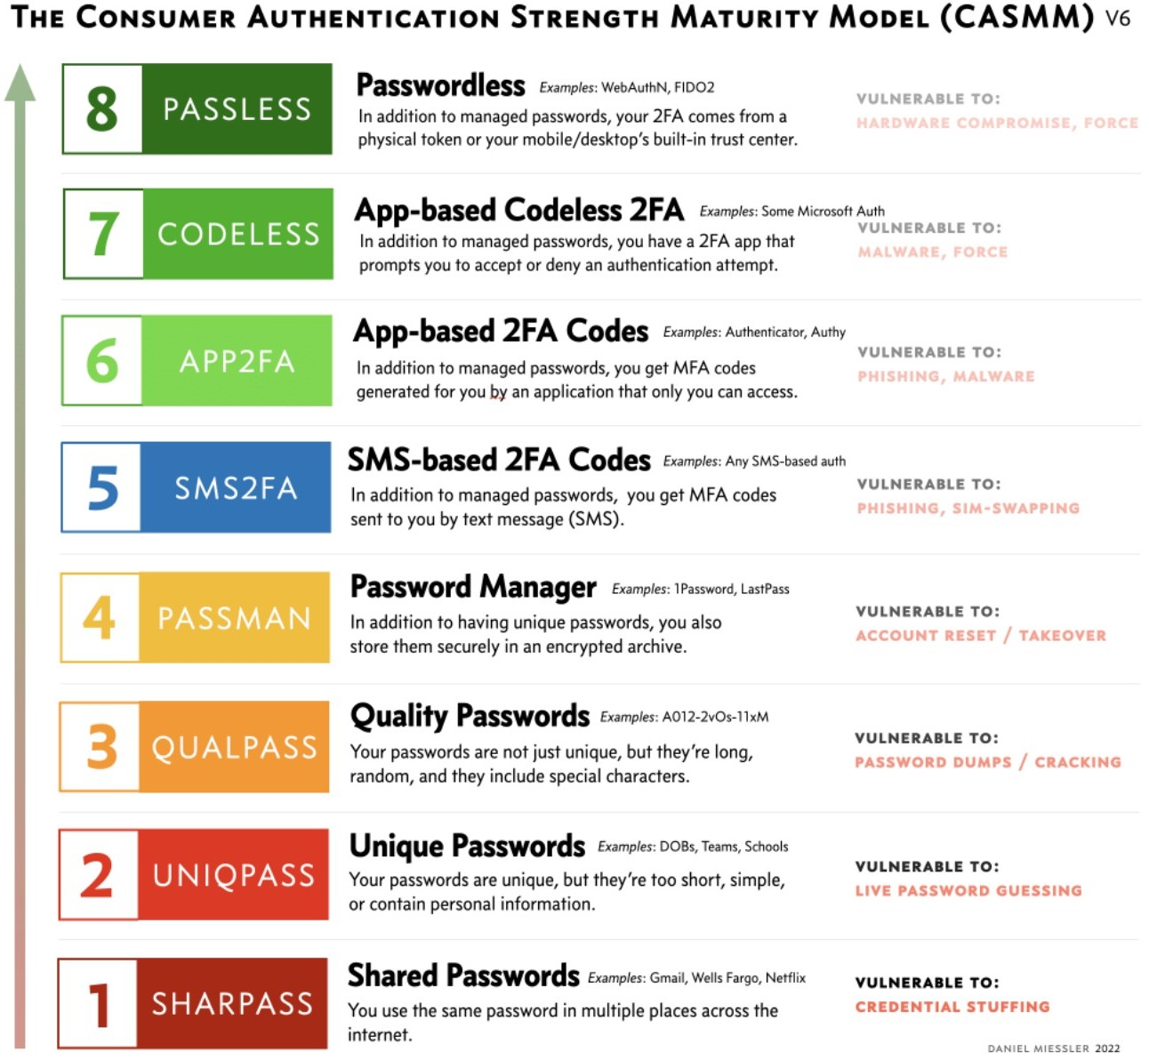
Weak Password Requirements
Having no or minimal controls over the quality of users’ passwords.
Very short or blank
Common dictionary words or names
Password is the same as the
username
Use of default password
Missing or ineffective MFA
Link: https://danielmiessler.com/blog/casmm-consumer-authentication- security-maturity-model/

Slide 5
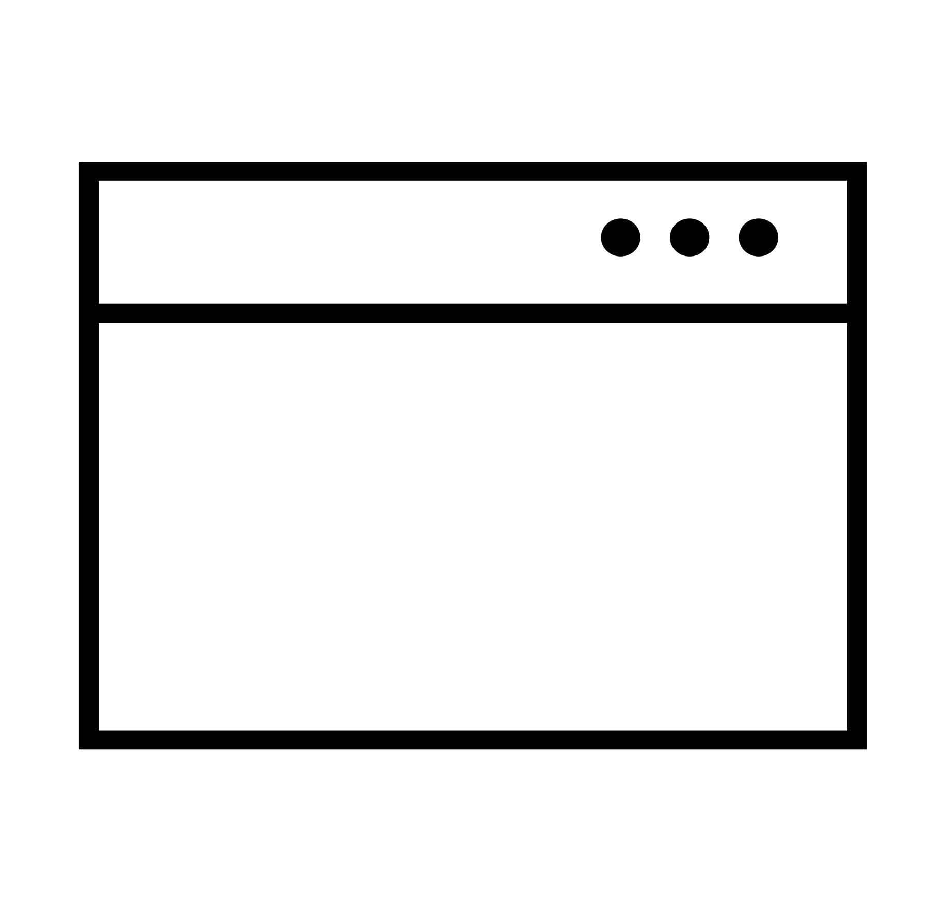


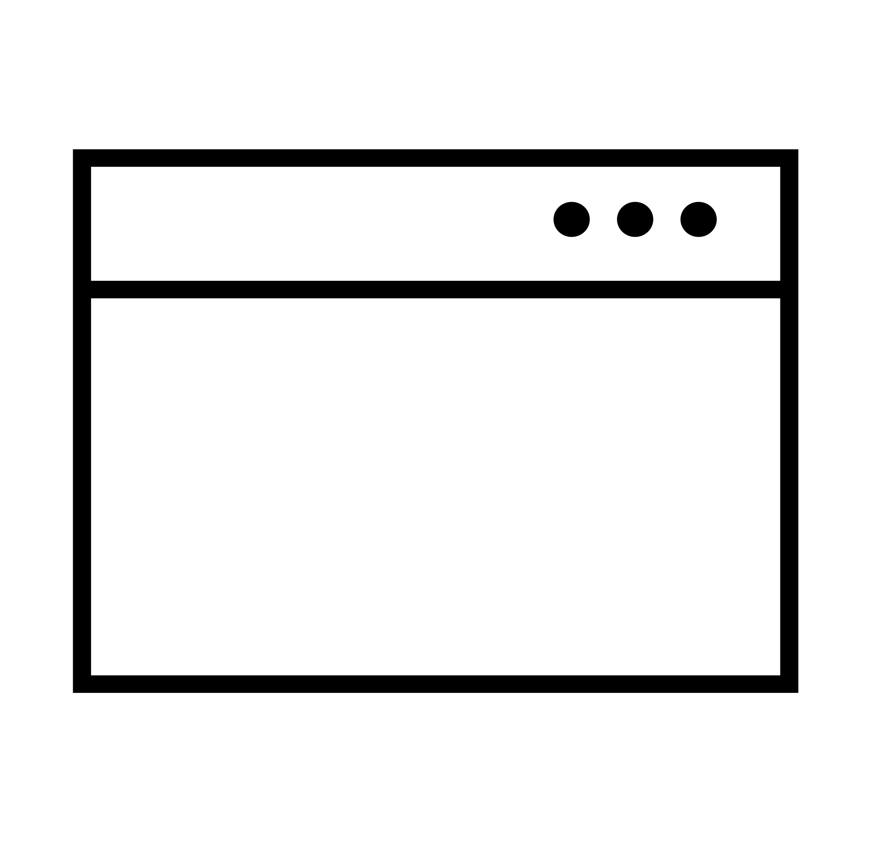
Improper Restriction of Authentication Attempts
Application permits brute force or other automated attacks.
Login Page
Login page
OTP / MFA page
Change password page
Username
Password
OTP Page
Enter one-time code available on the Authenticator app.

Slide 6
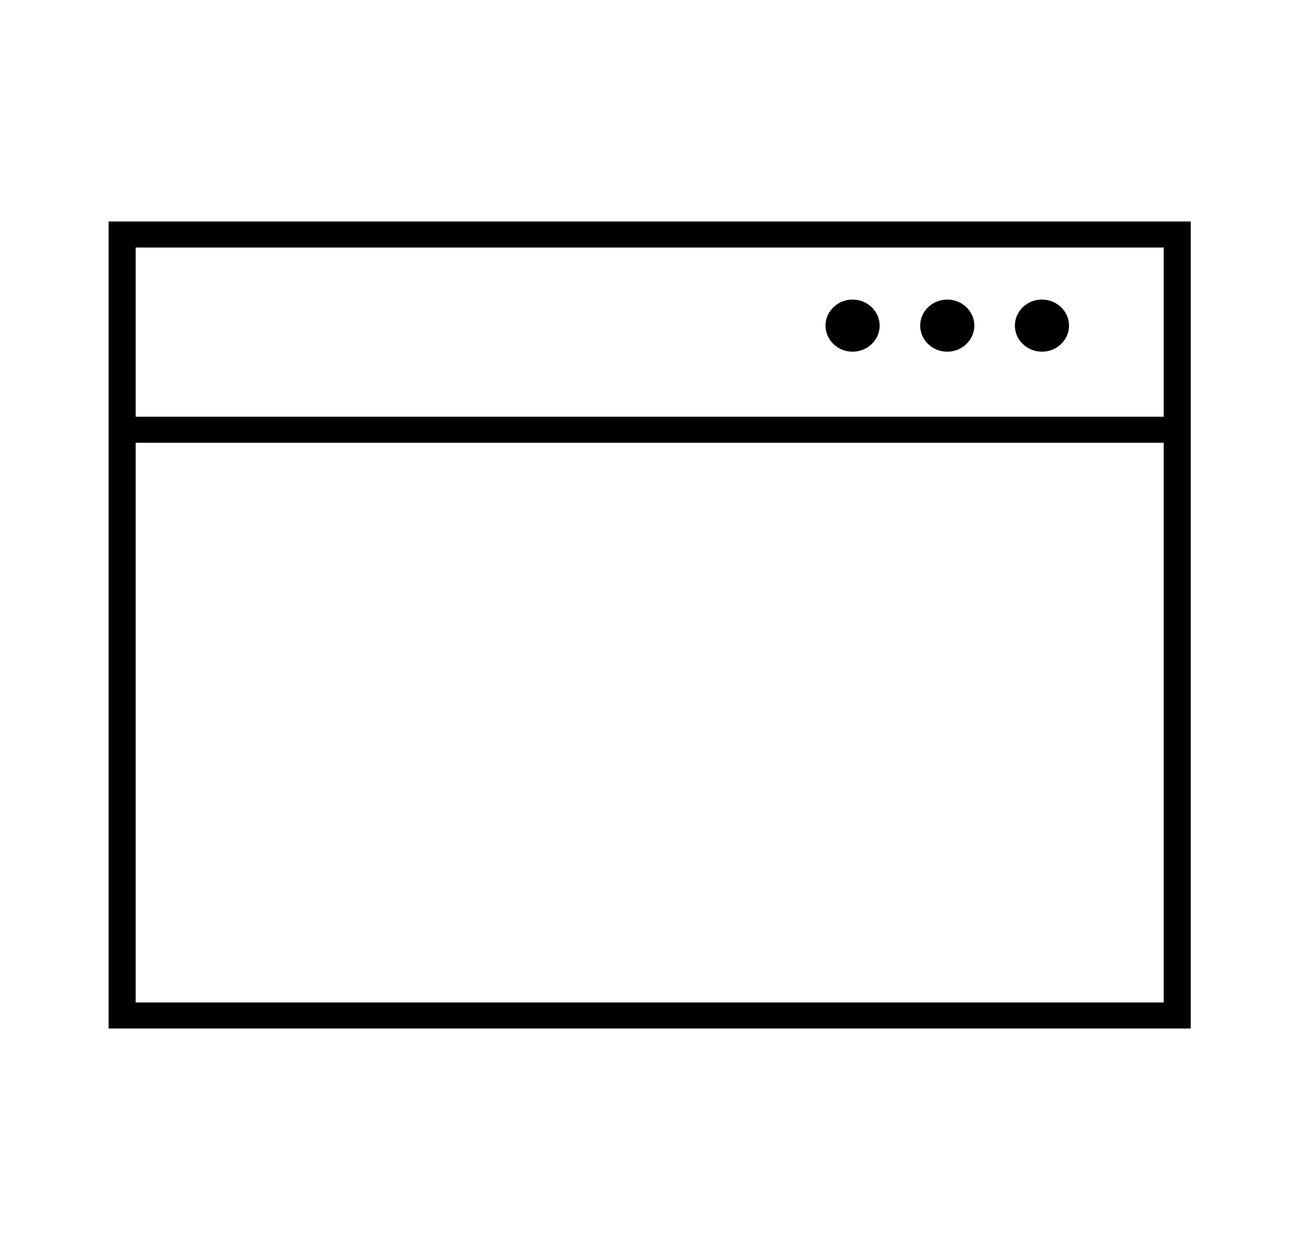
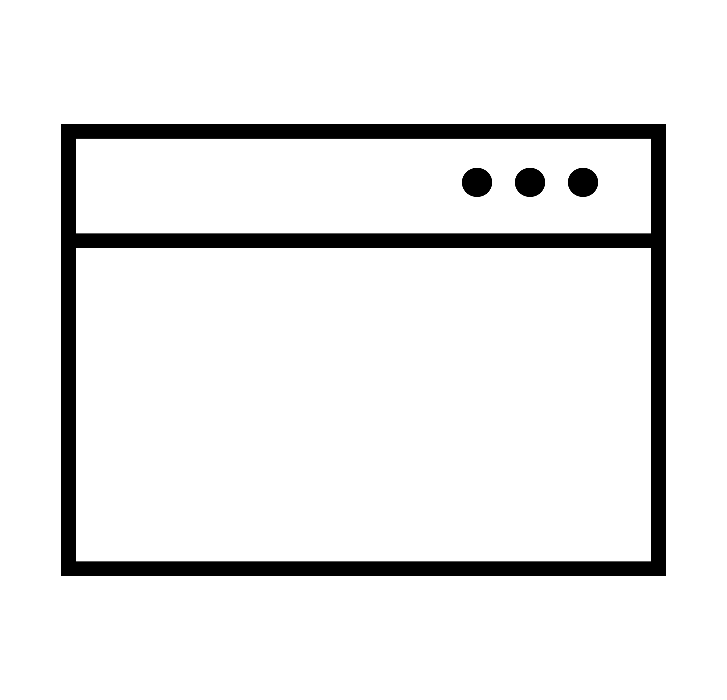




Verbose Error Message
The application outputs a verbose error message that allows for username enumeration.
Incorrect Username
Incorrect Password
Sign in failed. Incorrect username.
VS
Sign in failed. Incorrect password.
Username
Username
Password
Password

Slide 7
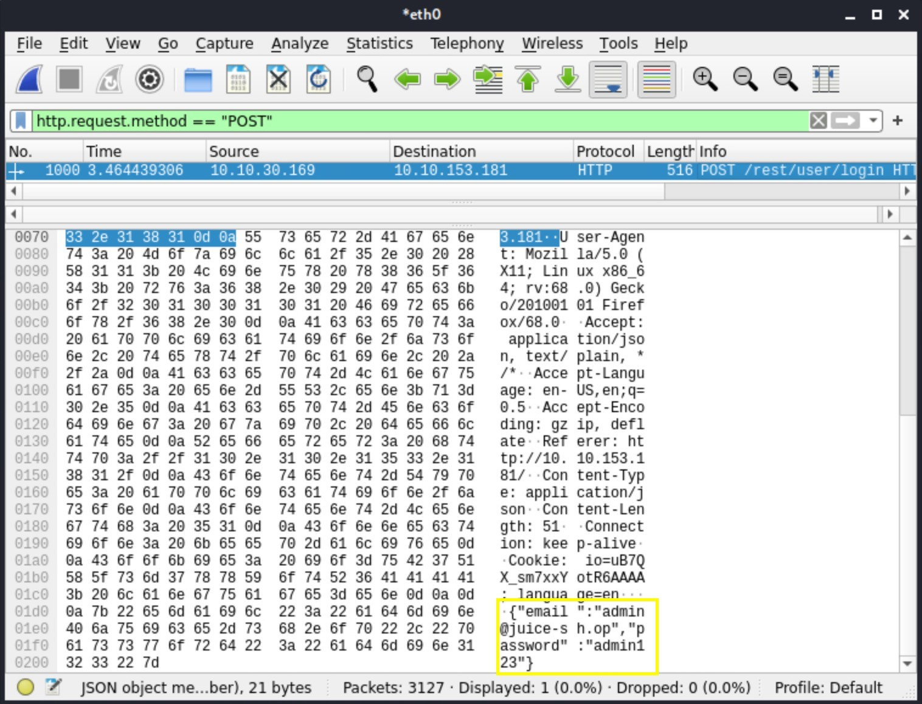
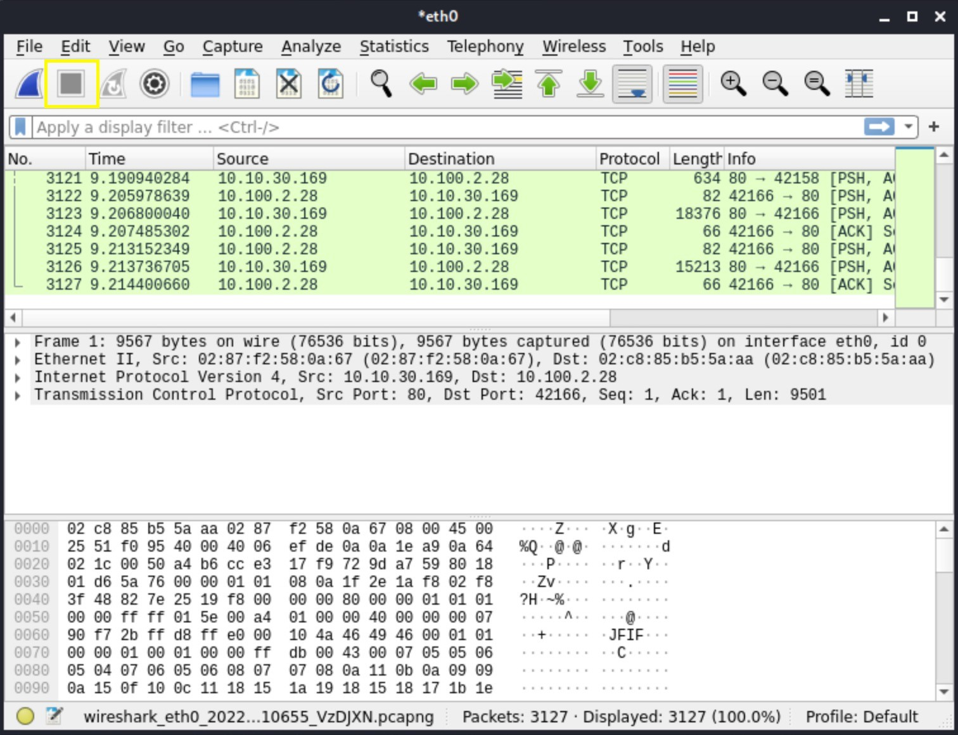
Vulnerable Transmission of Credentials
The application uses an unencrypted HTTP connection to transmit login credentials.
HTTP
HTTPS
VS

Slide 8
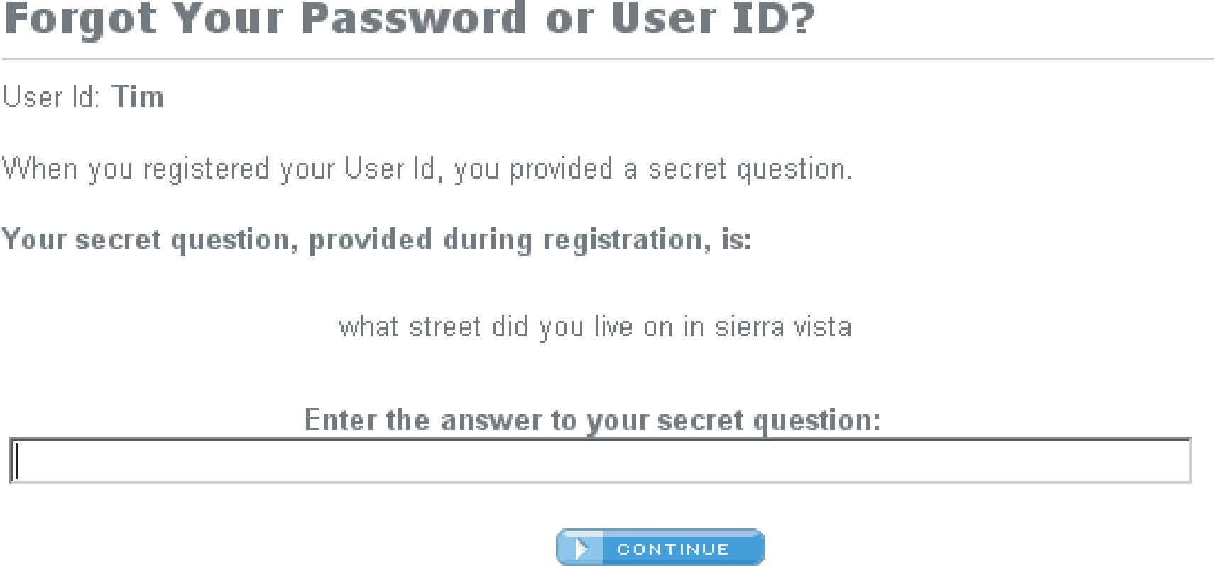
Insecure Forgot Password Functionality
Design weaknesses in the forgotten password functionality usually make the weakest link that can be used to attack the application’s overall authentication logic.

Slide 9
Defects in Multistage Login Mechanism
Insecure implementation of the MFA function.
REQUEST 1
REQUEST 2
POST
Host:
...
/login-steps/first HTTP/1.1 vulnerable-website.com
POST /login-steps/second HTTP/1.1 Host: vuln-website.com Cookie:
account=carlos
...
verification-code=123456
username=carlos&password=qwerty
How can this be exploited?
Change the “account” cookie to the victim’s username and compromise the victim’s account.

Slide 10


Insecure Storage of Credentials
Uses plain text, encrypted, or weekly hashed password data stores.
Algorithm | Password
None | Password1!
AES256 and B64 | jc2ZRviEVUuLV7Ljc2q7YQ==
MD5 | 0cef1fb10f60529028a71f58e54ed07b
SHA256 | 1D707811988069CA760826861D6D63A10E8C3B7F171C444 1A6472EA58C11711B

Slide 11

Impact of Authentication Vulnerabilities
Unauthorized access to the application.
Confidentiality – Access to other users’ data.
Integrity – Access to update other users’ data
Availability – Access to delete users and their data.
Can sometimes be chained with other vulnerabilities to gain remote code execution on the host operating system.

Slide 12

OWASP Top 10
OWASP Top 10 - 2013 | OWASP Top 10 - 2017 | OWASP Top 10 - 2021
A1 – Injection | A1 – Injection | A1 – Broken Access Control
A2 – Broken Authentication and Session Management A3 – Cross-Site Scripting (XSS) | A2 – Broken Authentication A3 – Sensitive Data Exposure | A2 – Cryptographic Failures A3 - Injection
A4 – Insecure Direct Object References | A4 – XML External Entities (XXE) | A4 – Insecure Design
A5 – Security Misconfiguration | A5 – Broken Access Control | A5 – Security Misconfiguration
A6 – Sensitive Data Exposure | A6 – Security Misconfiguration | A6 – Vulnerable and Outdated Components
A7 – Missing Function Level Access Control | A7 – Cross-Site Scripting (XSS) | A7 – Identification and Authentication Failures
A8 – Cross-Site Request Forgery (CSRF) | A8 – Insecure Deserialization | A8 – Software and Data Integrity Failures
A9 – Using Components with Known Vulnerabilities | A9 – Using Components with Known Vulnerabilities | A9 – Security Logging and Monitoring Failures
A10 – Unvalidated Redirects and Forwards | A10 – Insufficient Logging & Monitoring | A10 – Server-Side Request Forgery (SSRF)

Slide 13

HOW TO FIND AND EXPLOIT AUTHENTICATION FLAWS?

Slide 14
Weak Password Complexity Requirements
Review the website for any description of the rules.
If self registration is possible, attempt to
register several accounts with different kinds of weak passwords to discover what rules are in place.
Very short or blank.
Common dictionary words or names.
Password is the same as the username.
If you control a single account and password change is possible, attempt to change the password to various weak values.
Link: https://danielmiessler.com/blog/casmm-consumer-authentication-security- maturity-model/

Slide 15
Improper Restriction of Authentication Attempts
\
Manually submit several bad login attempts for an account you control.
After 10 failed login attempts, if the application does not
return a message about account lockout, attempt to log in correctly. If it works, then there is no lockout mechanism.
Login Page
Username
Password
Run a brute force attack to enumerate the valid password. Tools: Hydra, Burp Intruder, etc.
If the account is locked out, monitor the requests and
responses to determine if the lockout mechanism is insecure.
OTP Page
Enter one-time code available on the Authenticator app.
NOTE: Apply this test on all authentication pages.

Slide 16




Verbose Error Message
Submit a request with a valid username and an invalid password.
Submit a request with an invalid username.
Review both responses for any differences in the status code, any redirects, information displayed on the screen, HTML page source, or even the time to process the request.
If there is a difference, run a brute force attack to
enumerate the list of valid usernames in the application.
Incorrect Username
Sign in failed. Incorrect username.
Username
Password
Incorrect Password
Sign in failed. Incorrect password.
Username
NOTE: Apply this test on all authentication pages.
Password

Slide 17
Vulnerable Transmission of Credentials
Perform a successful login while monitoring all traffic in both directions between the client and server.
Look for instances where credentials are submitted in a URL
query string or as a cookie, or are transmitted back from the server to the client.
Attempt to access the application over HTTP and if there are
any redirections to HTTPS.
HTTP
HTTPS

Slide 18
Insecure Forgot Password Functionality
Identify if the application has any forgotten password functionality.
If it does, perform a complete walk-through of the forgot password functionality using an account you have control of while intercepting the requests / responses in a proxy.
Review the functionality to determine if it allows for username enumeration or brute-
force attacks.
If the application generates an email containing a recovery URL, obtain a number of these URLs and attempt to identify any predictable patterns or sensitive information included in the URL. Also check if the URL is long lived and does not expire.

Slide 19
Defects in Multistage Login Mechanism
Identify if the application uses a multistage login mechanism.
If it does, perform a complete walk-through using an account you have control of while intercepting the requests / responses in a proxy.
Review the functionality to determine if it allows for username enumeration or brute-
force attacks.
REQUEST 1
REQUEST 2
POST
Host:
...
/login-steps/first HTTP/1.1 vulnerable-website.com
POST /login-steps/second HTTP/1.1 Host: vuln-website.com Cookie:
account=jamal
...
verification-code=123456
username= jamal&password=qwerty

Slide 20




Insecure Storage of Credentials
Review all the application’s authentication related functionality. If you find any instances where the user ’s password is transmitted to the client (plaintext or obfuscated, this indicates the passwords are being stored insecurely.
If you gain remote code execution (RCE) on the server, review the database to
determine if the passwords are stored insecurely.
Conduct technical interviews with the developers to review how passwords are stored in the backend database.
Algorithm | Password
None | Password1!
AES256 and B64 | jc2ZRviEVUuLV7Ljc2q7YQ==
MD5 | 0cef1fb10f60529028a71f58e54ed07b
SHA256 | 1D707811988069CA760826861D6D63A10E8C3B7F171C4441A6472EA58C11711B

Slide 21
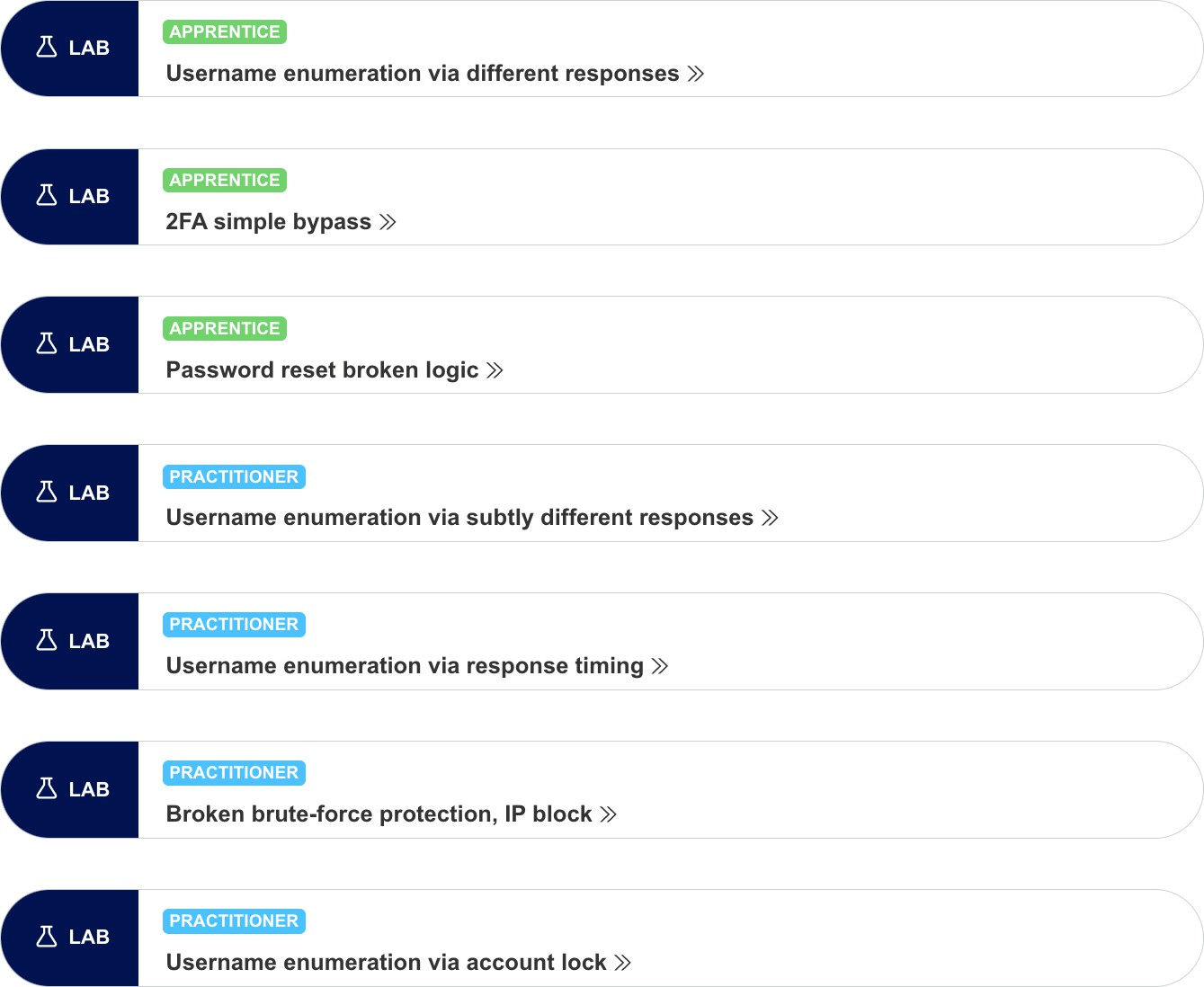
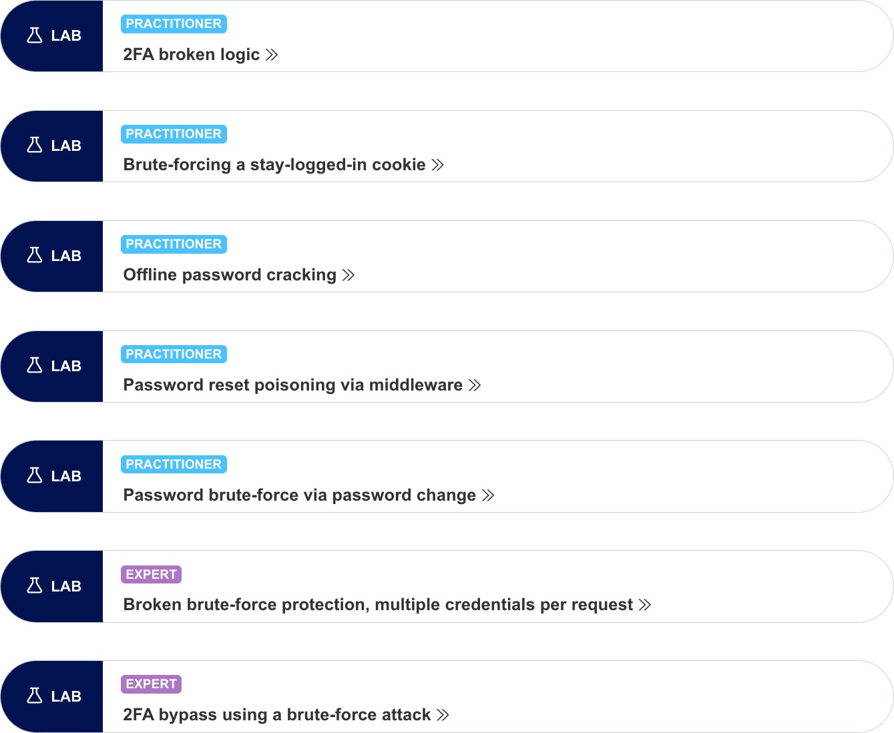
Exploiting Authentication Flaws Labs

Slide 22
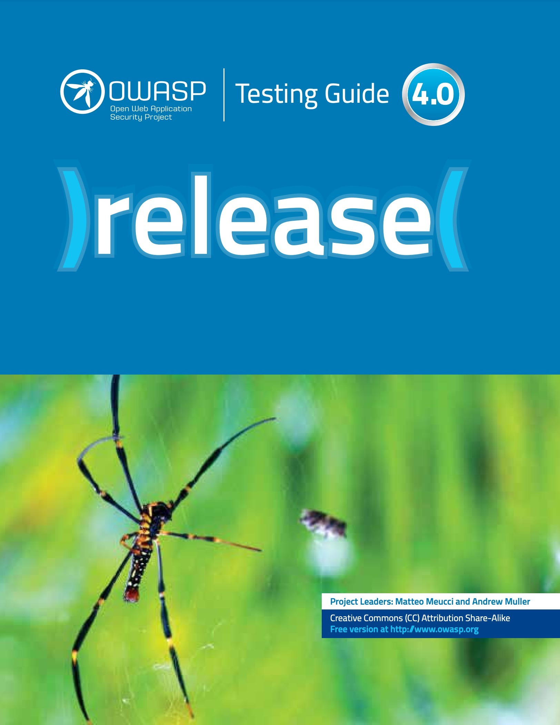
Web Application Security
Testing (WSTG) Guide
4.4 Authentication Testing
Testing Guide Link: : https://owasp.org/www-project-web-security-testing-guide/assets/archive/OWASP_Testing_Guide_v4.pdf

Slide 23

HOW TO PREVENT AUTHENTICATION VULNERABILITIES?

Slide 24
Preventing Authentication Vulnerabilities
Wherever possible, implement multi-factor authentication.
Change all default credentials.
Always use an encrypted channel / connection (HTTPS) when sending user credentials.
Only POST requests should be used to transmit credentials to the
server.
Stored credentials should be hashed and salted using cryptographically secure algorithms.
Use identical, generic error messages on the login form when the
user enters incorrect credentials.

Slide 25
Preventing Authentication Vulnerabilities
...
Implement an effective password policy that is compliant with NIST 800-63-b’s guidelines.
Use a simple password checker to provide real time feedback on
the strength of the password. For example: zxcvbn JavaScript library.
Implement robust brute force protection on all authentication pages.
Audit any verification or validation logic thoroughly to eliminate flaws.

Slide 26
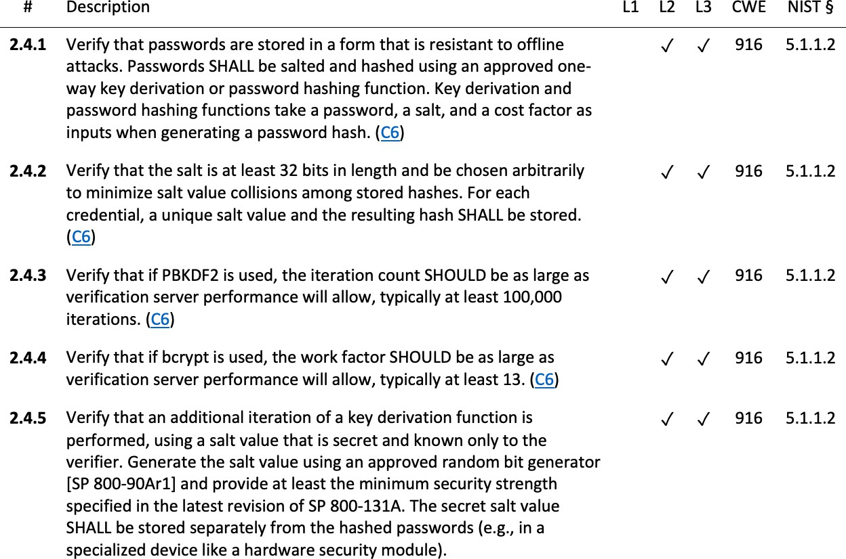
Application Security Verification Standard (ASVS)
V2: Authentication
Verification Requirements
ASVS Guide Link: : https://owasp.org/www-pdf-archive/OWASP_Application_Security_Verification_Standard_4.0-en.pdf

Slide 27
Resources
Web Security Academy – Authentication Vulnerabilities
https://portswigger.net/web-security/authentication
Web Application Hacker ’s Handbook
Chapter 6 – Attacking Authentication
OWASP Web Security Testing Guide – Authentication Testing
https://owasp.org/www-project-web-security-testing-guide/stable/4- Web_Application_Security_Testing/04-Authentication_Testing/README
OWASP Top 10 – A07 Identification and Authentication Failures
https://owasp.org/Top10/A07_2021-Identification_and_Authentication_Failures/
OWASP Application Security Verification Standard – V2 Authentication Verification Requirements
https://owasp.org/www-pdf-archive/OWASP_Application_Security_Verification_Standard_4.0-
en.pdf

